Slide 1
AMOLED PANEL
Name: Saurav Kumar
Reg. No: 12000000
Roll No: RK20YGA01
Subject: PHY-109
Topic: Amoled Panel
Task: CA-1 (PPT)
Submitted to: Dr. Dipal B. Patel
By: Saurav Kumar

Slide 2
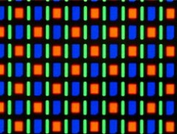
AMOLED PANEL
Intoduction
Active-matrix organic light-emitting diode or AMOLED is a display technology that has become popular in different electronic devices such as smartphones, tablet computers, digital cameras, media players, smartwatches and even television sets.
Since 2007, AMOLED technology has been used in mobile phones, media players, TVs and digital cameras and it has continued to make progress toward low-power, low-cost, high resolution and large size (for example, 88-inch and 8K resolution) applications
Figure: OLED Structure
By: Saurav Kumar

Slide 3
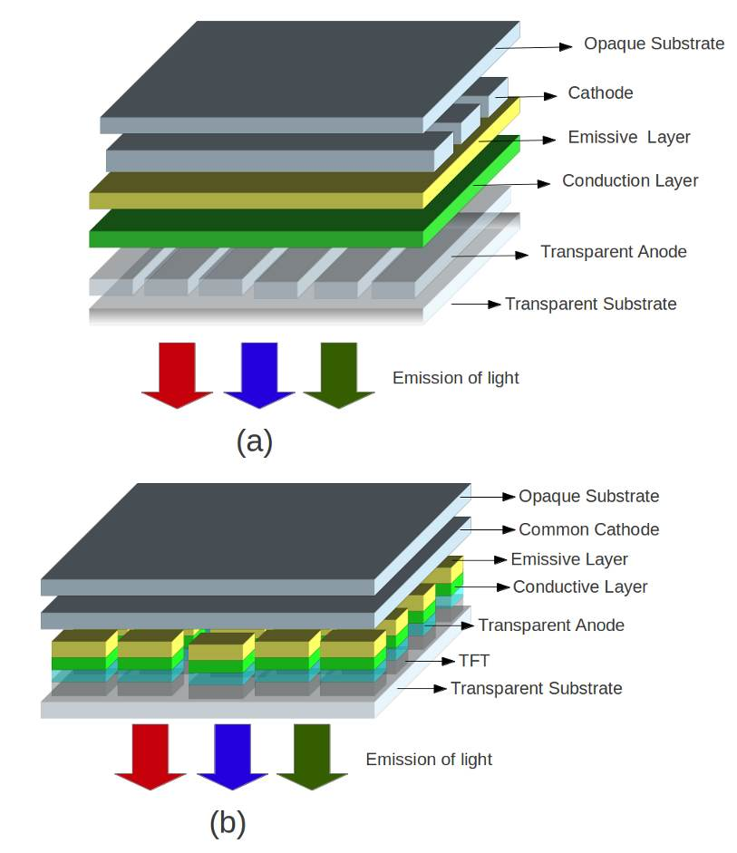
AMOLED PANEL
history
In year 1963, An organic molecule was reported by Pop and Coworkers.
In year 1975, Bernard Lechner is invented active matrix technology.
Component
Cathode
Emissive layer
Conducting layer
Anode
Substrate
TFT
By: Saurav Kumar
Figure: OLED Structure

Slide 4
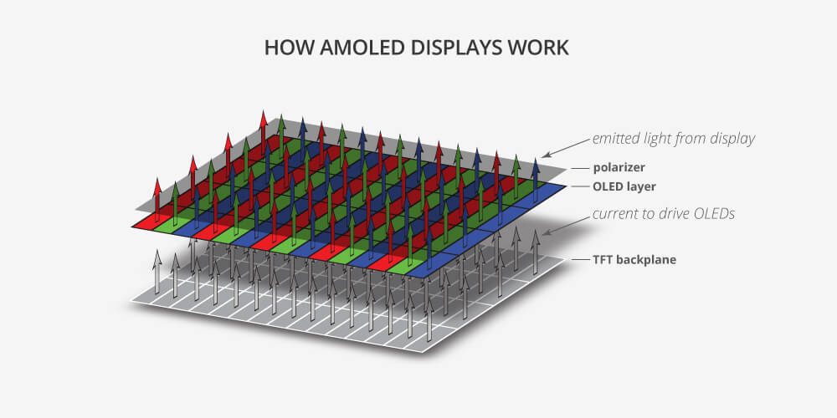
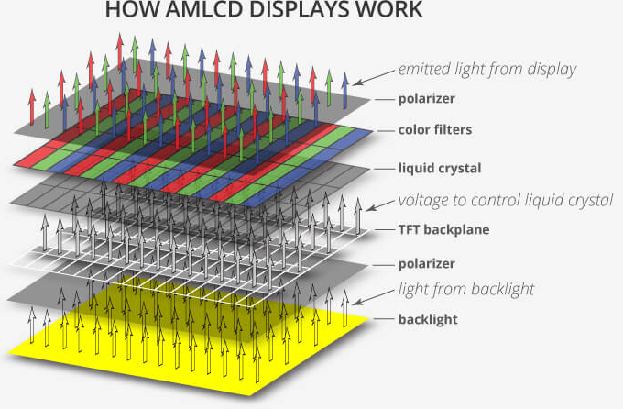
AMOLED PANEL
working
The AMOLED display consist of a matrix of OLED pixels, each having an Anode, Cathode, and a layer of organic material b/w them.
These pixels are activated by a thin film transistor which control each current pixel.
Typically two transistor are used for each pixel-one to turn the change to the pixel on and off, and second provide constant current.
Figure: Working Display
By: Saurav Kumar

Slide 5
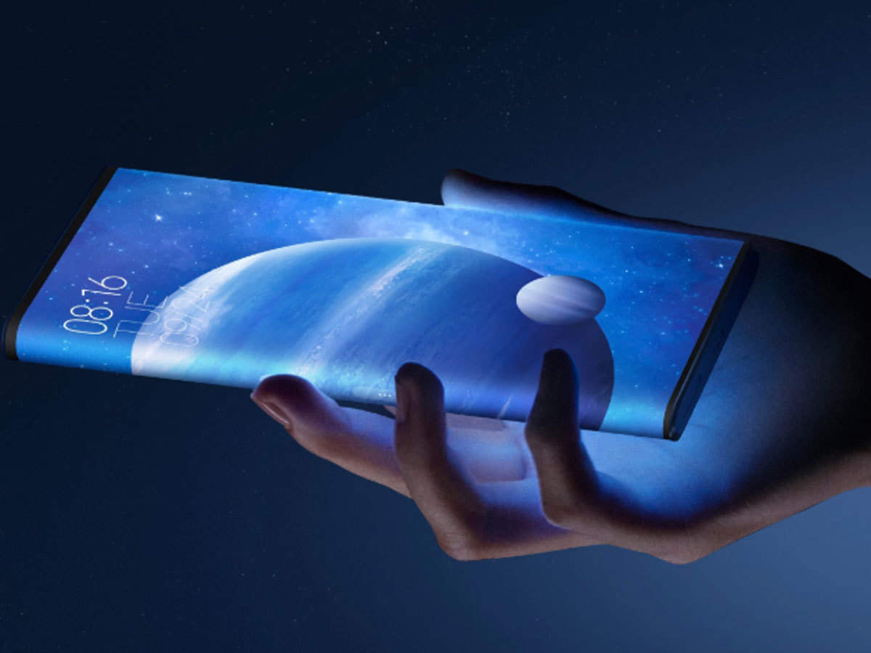
AMOLED PANEL
Principle
Electroluminescence(EL) is an optical and electrical phenomenon in which a material emits light in response to an electric current passed through it, or to a strong electric filed.
Applications
Higher contrast radio and Sun readability.
Thinner and Flexible.
Lighter weight.
Large viewing angle.
Brightness.
Less power consumption.
Faster response.
In this smartphone use Active-Matrix Organic Light-Emitting Diode
By: Saurav Kumar

Slide 6
AMOLED PANEL
comparison
AMOLED | LCD | PLASMA
1) Potentially the lowest cost. | 1) Medium cost. | 1) Highest cost.
2) Consumes lowest power. | 2) Lower power consumption than Plasma. | 2) Highest power consumption.
3) Self emissive. | 3) Requires blacklight. | 3) Requires blacklight.
4) Display wider color range. | 4) Color range not good. | 4) Display a very deep black.
5) No screen burn potential. | 5) No screen burn potential. | 5) Screen burn potential.
6) Shorter overall Lifetime. | 6) Backlight bulb typically requires replace at around 30k hours. | 6) Half-life 60k hours.
By: Saurav Kumar

Slide 7
AMOLED PANEL
advantages
disadvantages
Consumes Less Power
Thinner Physical Profile
High Contrast Ratio
Overall Display Quality
Short Lifespan Due to Degradation
Vulnerability to Water Damage.
Poor Outdoor Visibility.
Some Display Quality Issues.
The possibility of producing innovative form factors is also another advantage of AMOLED. This display technology supports the design and development of thin and flexible electronic displays.
High demands for products with shorter product lifecycle such as smartphones and tablet computers coupled with market competition offset the problem concerning the short lifespan of AMOLED panels. Possibly, by the time an AMOLED panel starts demonstrating widespread pixel degradation, a user would have already bought and owned a newer device.
By: Saurav Kumar

Slide 8
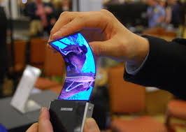
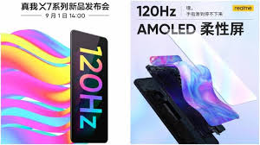
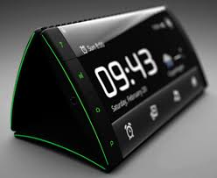
AMOLED PANEL
Some of the present gadgets
By: Saurav Kumar

Slide 9
?
Any Questions

Slide 10






THANK
YOU
https://www.linkedin.com/in/sauravhathi/
https://www.facebook.com/
Saurav Hathi
dummymail@gmail.com
+919999999999

